Slide 1
Application Development using Node JS

Slide 2
Node JS
Topics to be covered
Understanding Node.js Event Model
Blocking I/O in Node.js
Adding work to the Event Queue
Using nextTick to schedule work
Implementing Event Emitters and Listeners
Implementing Callbacks
Implementing Closure in Callbacks
Chaining Callbacks

Slide 3
Understanding the Node.js Event Model
Every task on a computer is referred as an Event.
File open
Connection is established with peer
Some occurrences like system generated notifications
Key press, click, mouse movement

Slide 4
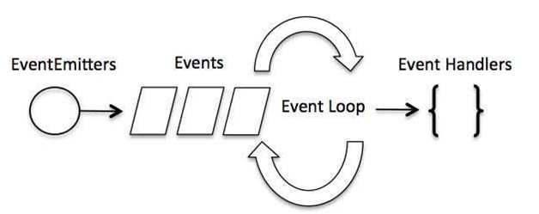
Understanding the Node.js Event Model

Slide 5
Difference between Events and Callbacks:
Although, Events and Callbacks look similar but the differences lies in the fact that callback functions are called when an asynchronous function returns its result where as event handling works on the observer pattern.
Whenever an event gets fired, its listener function starts executing. Node.js has multiple in-built events available through events module and EventEmitter class which is used to bind events and event listeners.

Slide 6
Understanding the Node.js Event Model
EventEmitter – class
Require(‘events’);
To include Events moudles
eventEmitter =new EventEmitter();
Object
eventEmitter.on(eventName,Listener);
To register the listener
eventEmitter.emit(eventName[args,..])
triggers the specific event

Slide 7
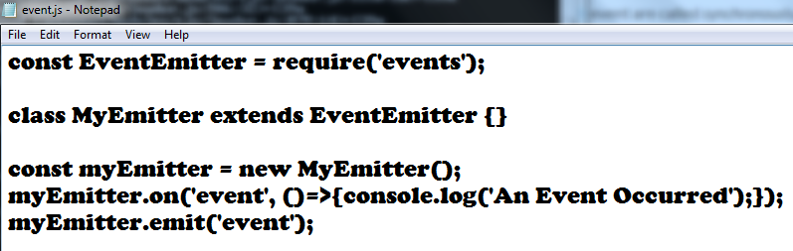
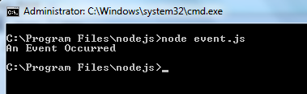
Understanding the Node.js Event Model

Slide 8
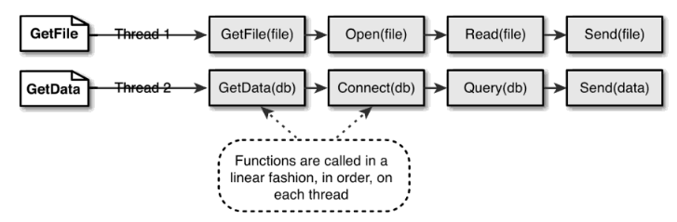
Understanding the Node.js Event Model
Comparing Event Callbacks and Threaded Model
Threaded Model

Slide 9
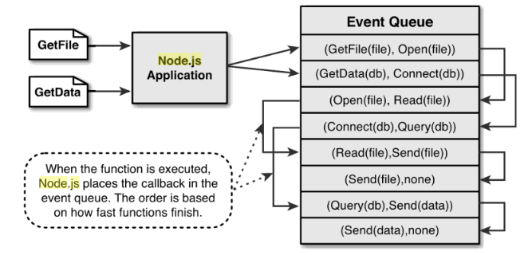
Understanding the Node.js Event Model
Single Event driven thread

Slide 10
Understanding the Node.js Event Model
Blocking I/O in Node.js
Ends the execution of a current thread and waits for a response before continuing.
Examples
Reading File
Querying a DB
Requesting a socket
Accessing a remote service

Slide 11
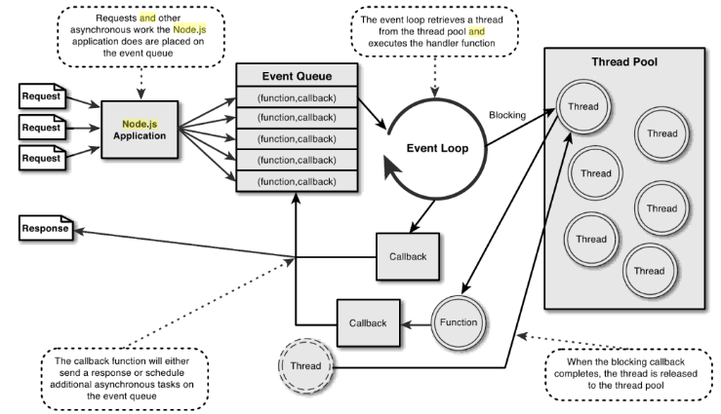
Understanding the Node.js Event Model
Node.js Event Model

Slide 12
Understanding the Node.js Event Model
Conversation Example
Traditional Web Server Threaded Model
Node.js Event Model

Slide 13
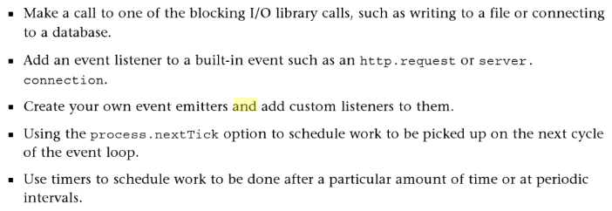
Understanding the Node.js Event Model

Slide 14
Adding work to the Event Queue
Implementing Timers
It provides a facility to delay execution of code for a period of time
Three types of timers in Node.js
Timeout
Interval
Immediate timers

Slide 15
Adding work to the Event Queue
Delaying work with Timeouts
setTimeout(callback,delayMilliSeconds, [args])
ClearTimeout(timeoutId)

Slide 16
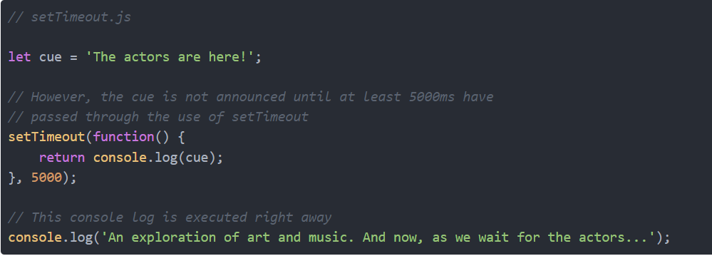
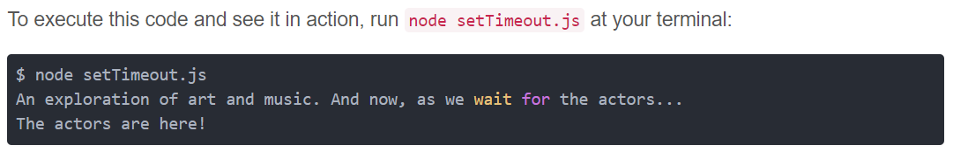

Slide 17
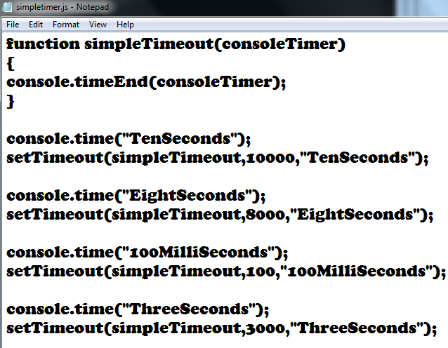
Delaying work with Timeouts

Slide 18
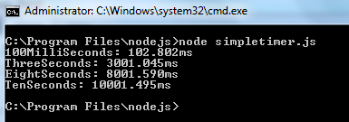
Delaying work with Timeouts

Slide 19
Adding work to the Event Queue
Performing Periodic work with Intervals
setInterval(callback,delayMilliSeconds, [args])
ClearInterval(IntervalId)

Slide 20
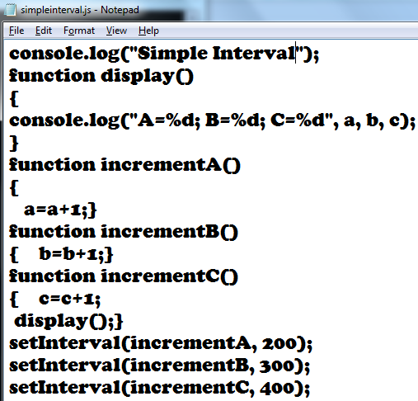
Performing Periodic work with Intervals

Slide 21
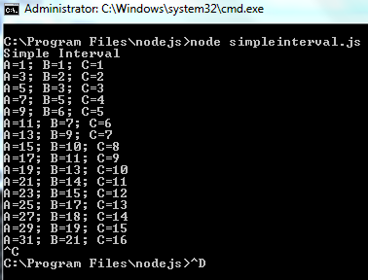
Performing Periodic work with Intervals

Slide 22
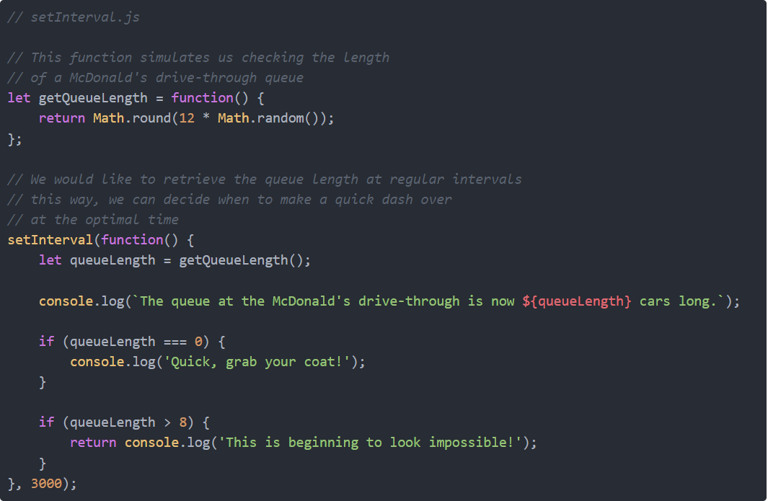

Slide 23
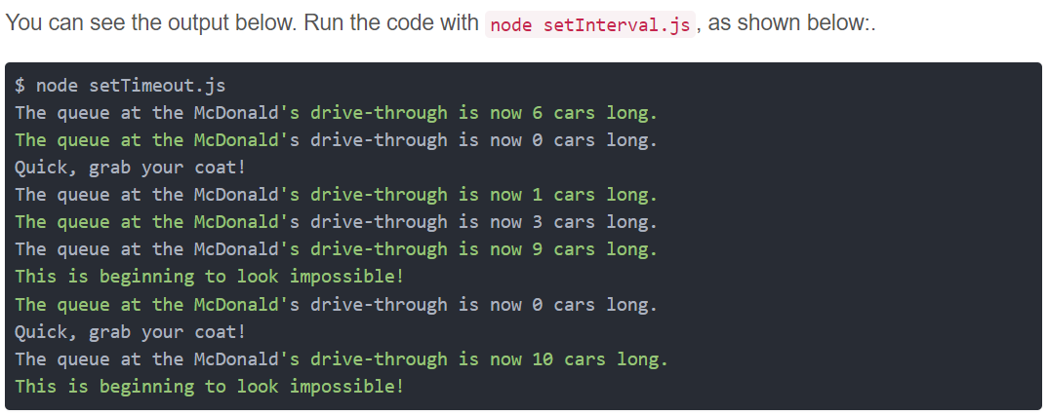

Slide 24
Adding work to the Event Queue
Performing immediate work with an Immediate timer
setImmediate(callback, [args])
ClearImmediate(immediateId)
Dereferencing Timers from Event Loop
unref()
Rereferencing Timers from Event Loop
ref()

Slide 25
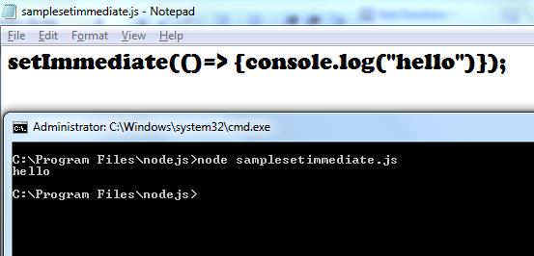
Performing immediate work with an Immediate timer

Slide 26
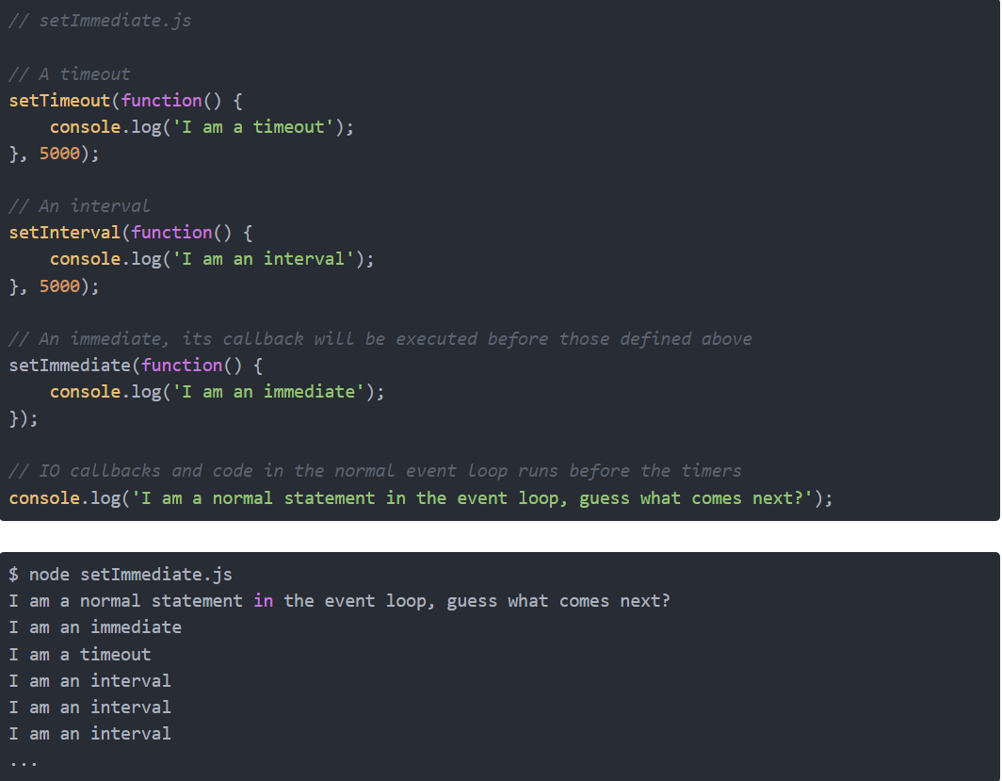

Slide 27
Adding work to the Event Queue
Using nextTick to schedule work
process.nextTick() executes before the I/O events are triggered
Process.maxTickDepth - 1000
To avoid starvation
To implement a sequence of blocking fs calls , immediate timers, and nextTick()

Slide 28
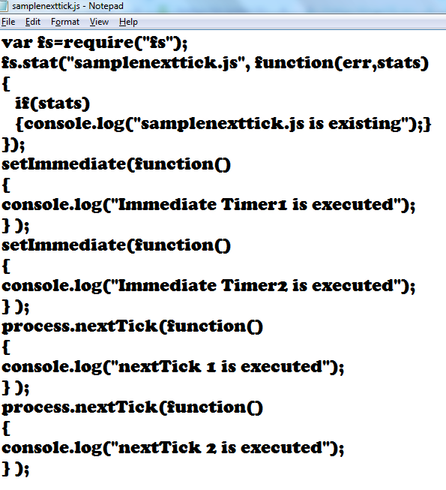
Adding work to the Event Queue

Slide 29
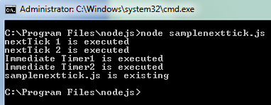
Adding work to the Event Queue

Slide 30
Adding work to the Event Queue
Implementing Event Emitters and Listeners
To create own custom events and listener callback
Adding custom events to Java script objects
Adding Event Listeners to Objects
Removing Listeners from Objects
Implementing Event Listeners and Event Emitters

Slide 31
Adding work to the Event Queue
Adding custom events to Java script object
To create simple event emitter
var events=require(‘events’);
var emitter=new events.EventEmitter();
emitter.emit(“simplevent”);

Slide 32
Adding work to the Event Queue
To add the events directly to java script object
Inherit eventEmitter functionality
Function Myobj()
{ Events.EventEmitter.call(this); } Myobj.prototype._proto_=evets.EventEmitter.prototype;
Emit events directly from instance of object
var Myobj = new Myobj();
Myobj.emit(“someEvent”);

Slide 33
Adding work to the Event Queue
Adding Event Listeners to Objects
To add listeners to EventEmitter object
.addListener(eventname, callback)
.on(eventname, callback)
.once(eventname, callback)

Slide 34
Adding work to the Event Queue
Removing Listeners from Objects
.listeners(evetName)
.setMaxListeners(n)
.removeListeners(eventname, callback)

Slide 35
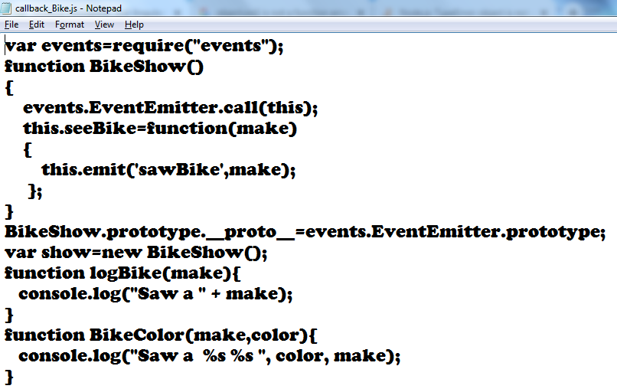
Implementing Callbacks
Passing Additional Parameters to Callbacks

Slide 36
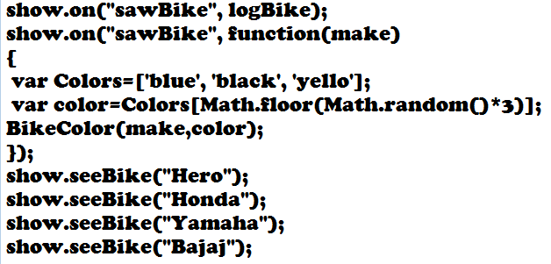
Implementing Callbacks
Passing Additional Parameters to Callbacks

Slide 37
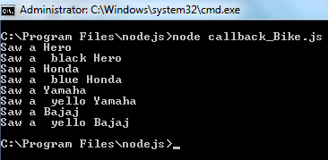
Implementing Callbacks
Passing Additional Parameters to Callbacks

Slide 38
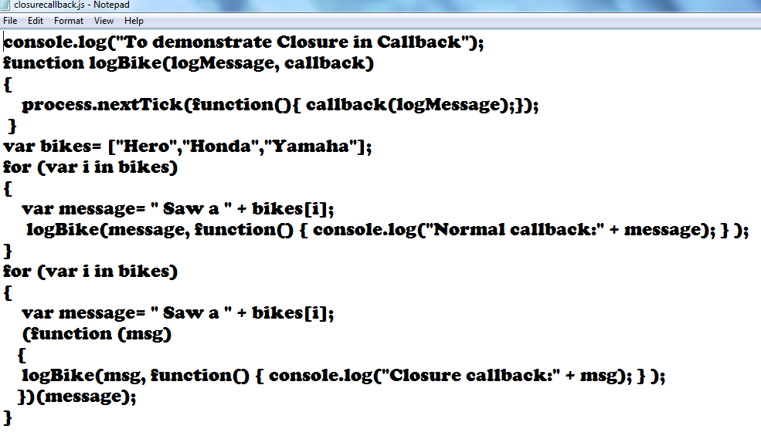
Implementing Callbacks
Implementing closure in Callbacks

Slide 39
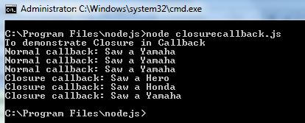
Implementing Callbacks
Implementing closure in Callbacks

Slide 40
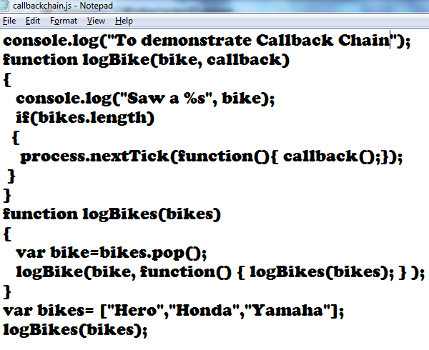
Implementing Callbacks
Chaining Callbacks

Slide 41
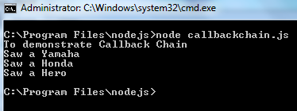
Implementing Callbacks
Chaining Callbacks

Slide 42
Thank you

